Slide 1
SORTED DICTIONARY

Slide 2
What is SortedDictionary<TKey, TValue> Collection
The SortedDictionary<TKey, TValue> is a Generic Collection class in C# which is used to store the key/value pairs in the sorted form and the sorting is done based on the key. The SortedDictionary<TKey, TValue> class uses the concept of the hashtable. As it is a Generic Collection, so, it belongs to System.Collections.Generic namespace.
The keys of the SortedDictionary collection must be unique and maintains ascending order based on the key. With the help of a key, we can easily search or remove elements from the generic SortedDictionary<TKey, TValue> collection.
It is dynamic in nature which means the size of the sorted dictionary is increased automatically as we added key/value pairs to the collection. The keys of SortedDictionary<TKey, TValue> collection cannot be null but the value can be null for a reference type.

Slide 3
How to Create a SortedDictionary<TKey, TValue> collection
The Generic SortedDictionary<TKey, TValue> Collection class in C# privided the following Constructors that we can use to create an instance of SortedDictionary class.
SortedDictionary(): It initializes a new instance of the Generic SortedDictionary class that is empty and uses the default System.Collections.Generic.IComparer implementation for the key type.
SortedDictionary(IComparer<TKey> comparer): It initializes a new instance of the Generic SortedDictionary class that is empty and uses the specified System.Collections.Generic.IComparer implementation to compare keys. The parameter comparer specifies the System.Collections.Generic.IComparer implementation to use when comparing keys, or null to use the default System.Collections.Generic.Comparer for the type of the key.
SortedDictionary(IDictionary<TKey, TValue> dictionary): It initializes a new instance of the Generic SortedDictionary class that contains elements copied from the specified System.Collections.Generic.IDictionary and uses the default System.Collections.Generic.IComparer implementation for the key type. The parameter comparer specifies the System.Collections.Generic.IDictionary whose elements are copied to the new Generic SortedDictionary. If the dictionary is null, then it will throw ArgumentNullException. If the dictionary contains one or more duplicate keys, then it will throw ArgumentException.
SortedDictionary(IDictionary<TKey, TValue> dictionary, IComparer<TKey> comparer): It initializes a new instance of the Generic SortedDictionary class that contains elements copied from the specified System.Collections.Generic.IDictionary and uses the specified System.Collections.Generic.IComparer implementation to compare keys. The parameter comparer specifies the System.Collections.Generic.IDictionary whose elements are copied to the new Generic SortedDictionary. The parameter comparer specifies the System.Collections.Generic.IComparer implementation to use when comparing keys, or null to use the default System.Collections.Generic.Comparer for the type of the key. If the dictionary is null, then it will throw ArgumentNullException. If the dictionary contains one or more duplicate keys, then it will throw ArgumentException

Slide 4
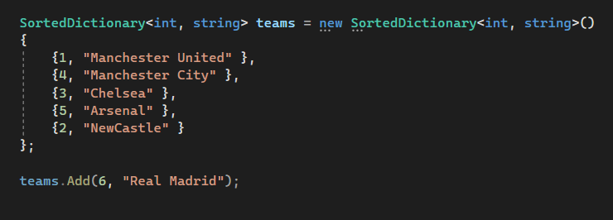
How to Add Elements into a Generic SortedDictionary Collection
If you want to add a key/value pair to a Generic SortedDictionary Collection, then you need to use the Add() method provided by the Generic SortedDictionary class.
Add(TKey key, TValue value): The Add(TKey key, TValue value) method is used to add an element with the specified key and value into the Generic SortedDictionary collection. Here, the parameter key specifies the key of the element to add and the parameter value specifies the element to add. The value can be null for reference types. If the key is null, then it will throw ArgumentNullException and if an element with the same key already exists in the Generic SortedDictionary, then it will throw ArgumentException.

Slide 5
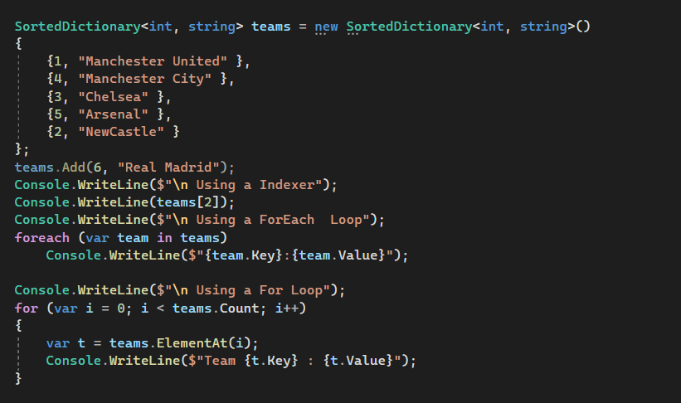
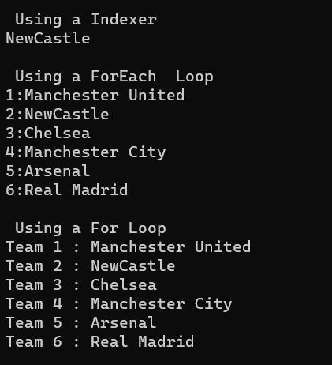
How to Access a Generic SortedDictionary<TKey, TValue> Collection
We can access the key/value pairs of the Generic SortedDictionary<TKey, TValue> Collection in C# using three different ways. They are as follows:
Using For-Each loop to access Generic SortedDictionary Collection
We can use a for-each loop to access the key/value pairs of the Generic SortedDictionary Collection in C# as follows
Using For Loop to access Generic SortedDictionary Collection
We can also use a for-each loop to access the key/value pairs of the Generic SortedDictionary Collection in C# as follows.
Using Index to Access Individual SortedDictionary Collection Elements in C#:
You can access the individual value of the Generic SortedDictionary Collection in C# by using the indexer..

Slide 6
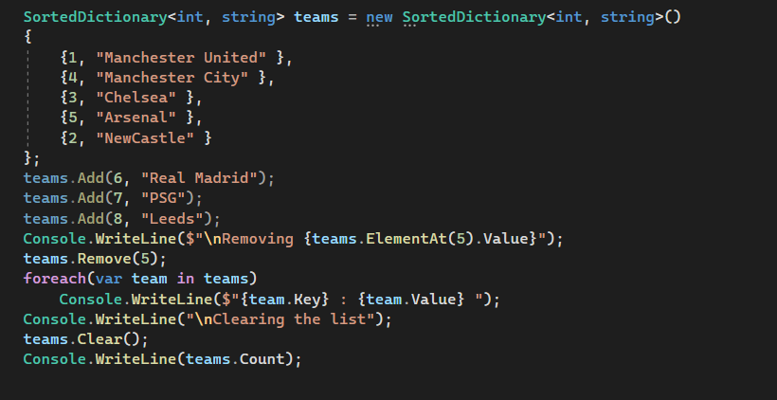
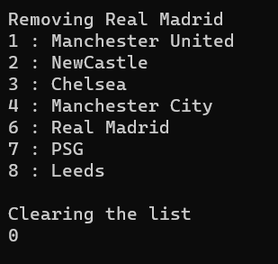
How to Remove Elements from a Generic SortedDictionary Collection
The Generic SortedDictionary Collection Class in C# provides the following methods to remove elements from SortedList.
Remove(TKey key): This method is used to remove the element with the specified key from the Generic SortedDictionary. The parameter key specifies the element to remove. It returns true if the element is successfully removed; otherwise, false. This method also returns false if the key was not found in the original Generic SortedDictionary. If the key is null, then it will throw ArgumentNullException.
Clear(): This method is used to remove all elements from a Generic SortedDictionary Collection

Slide 7
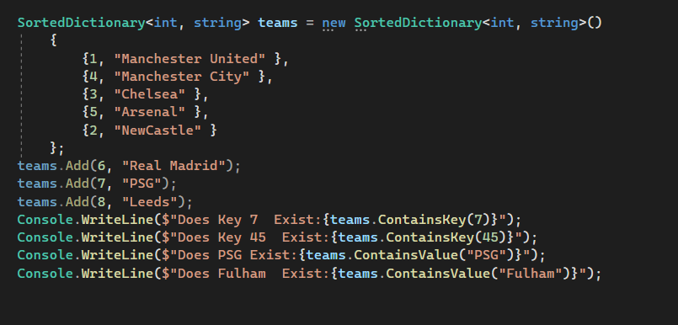
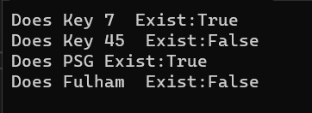
How to check the Availability of key/value Pairs in a Generic SortedDictionary Collection
If you want to check whether the key/value pair exists or not in the Generic SortedDictionary Collection in C#, then you can use the following methods provided by the Generic SortedDictionary<TKey, TValue> class as per your requirement i.e. whether you want to search for an element by key or an element by value.
ContainsKey(TKey key): This method is used to determine whether the Generic SortedDictionary collection contains a specific key. The parameter key to locating in the Generic SortedDictionary object. It returns true if the Generic SortedDictionary collection contains an element with the specified key; otherwise, false. If the key is null, then it will throw ArgumentNullException.
ContainsValue(TValue value): This method is used to determine whether a Generic SortedDictionary contains a specific value. The parameter value to locate in the Generic SortedDictionary collection. The value can be null for reference types. It returns true if the Generic SortedDictionary Collection contains an element with the specified value; otherwise, false.

Slide 8
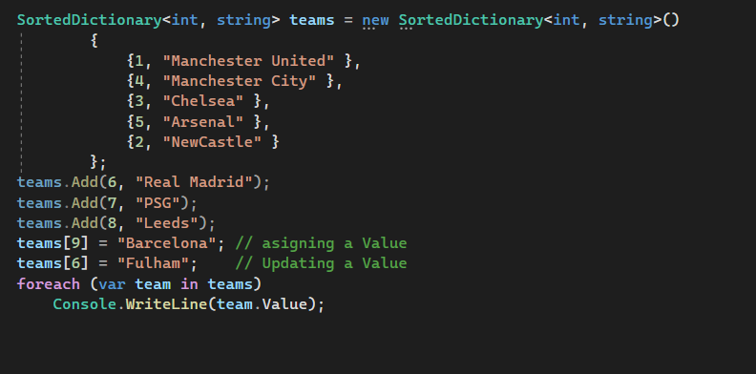
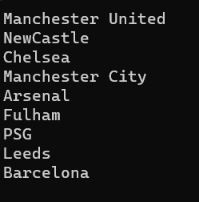
How to Assign Values to a SortedDictionary<TKey, TValue>
In order to add value to a SortedDictionary<TKey, TValue> with an indexer, we need to use square brackets after the SortedDictionary name. This is because a SortedDictionary works with key/value pairs, and we have to specify both key and value while adding the elements. The key is specified between square brackets. The syntax is given below.

